Slide 1
Section 6.1: Area between two curves

Slide 4
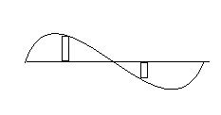
0 Π 2Π

Slide 5
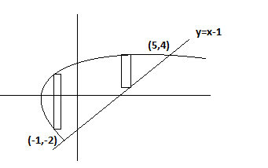
y² =2x+6
Or x= ½ y² -3

Slide 6
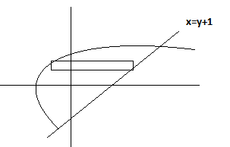
X=1/2 y² - 3

Slide 7
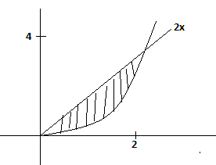
x²

